Slide 1

Intelligent AI Agent Travel Planner
Manuel Diaz

Slide 2
What Is the Project About?
Dual-path AI system for answering travel-related questions
1
Handles structured (SQL) and unstructured (semantic) data
2
Routes queries using language models + embeddings
3

Slide 3
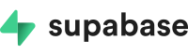

Two Retrieval Modes
Powered by LangGraph flow orchestration
SQL-Based Retrieval: Dates, destinations, trip info (via Supabase)
Vector Search: General table info, metadata, concepts (via Chroma)

Slide 4
Tech Stack
Supabase: SQL + real-time + pgvector
Chroma: Vector search for unstructured data
FastAPI + Uvicorn: High-performance async API
LangChain + LangGraph: LLM orchestration
OpenAI API: GPT models for smart logic

Slide 5
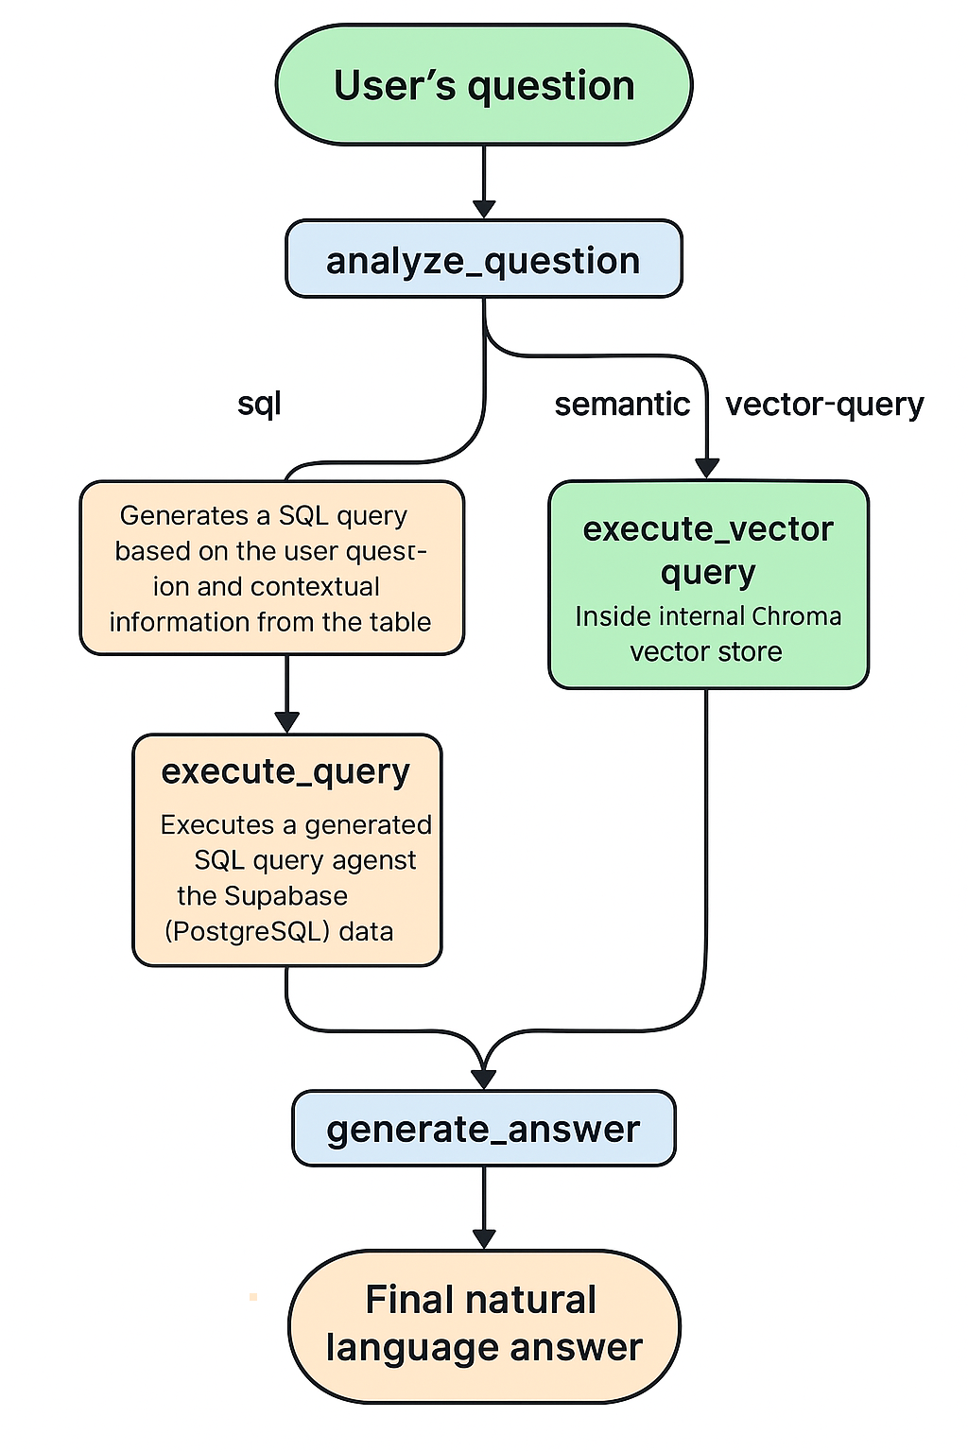
Retrieval Flow
User sends question
LangGraph classifies (SQL or general)
Runs SQL or vector search
GPT formats natural language answer

Slide 6
Project Structure (Layers)
core/: LangGraph logic
01
api/: FastAPI routes
02
services/: Supabase & OpenAI wrappers
03
db/: SQL connection logic
04
scripts/: Utilities & testing
05

Slide 7
Why This Structure Works
Clean separation of concerns
Easy maintenance & scaling
Ready for CI/CD & cloud deployment
Modular for future features

Slide 8
Deployment Options
Deploy as API service (Docker/Kubernetes)
PostgreSQL-compatible databases
Realtime embedding pipeline
CI/CD pipelines (GitHub Actions, etc.)

Slide 9
Future Enhancements
Query memory & conversation state
01
Personalized user experiences
02
Multimodal input (images, location)
03
Multilingual support
04
Real-time vector sync (webhooks + Prefect)
05
Monitoring & analytics

Slide 10

Summary & Impact
Dual-retrieval model powered by AI
Combines structured + semantic reasoning
Scalable, flexible, and production-ready
Ideal for intelligent assistants in any data-rich context

